Slide 1


Predicting water quality using deep learning techniques (GRU + LSTM)
Đỗ Quyết Thắng SIC251879
Artificial Intelligence Course

Slide 2

Predicting water quality using deep learning techniques
Unit 1. Introduction to the project
1.1. General information
1.2. Motivation and objectives
1.3. Project roadmap
Unit 2. Analyzing and Building Systems
2.1. Data collection
2.2. Data analysis (EDA)
2.3. Data preprocessing
Unit 3. Models and Results
3.1. GRU Model
3.2. LSTM Model
3.3. Hybrid Model
3.4. Model Comparison
Unit 4. Application
Samsung Innovation Campus
‹#›

Slide 3


1.1
General information
UNIT
01
The project is in the field of artificial intelligence and environment, using Python tools, Jupyter Notebook and deep learning libraries such as Keras and PyTorch to predict water quality based on input chemical data.
1.2.Motivation and goals
Water quality has a major impact on human health, especially in areas where testing is lacking. The project aims to apply deep learning to automate the water quality testing process, reducing time and costs compared to traditional methods.
Compare the performance of GRU, LSTM and Hybrid (GRU + LSTM) models. Propose the most effective model for practical application.
Samsung Innovation Campus
Project Name
‹#›

Slide 4
1.3.
Project roadmap
UNIT
01
The project is divided into 4 main phases:
(1) Research the topic.
(2) Process and explore data.
(3) Build and evaluate deep learning models.
(4) Synthesize results and prepare a report.
Samsung Innovation Campus
Project Name
‹#›

Slide 5
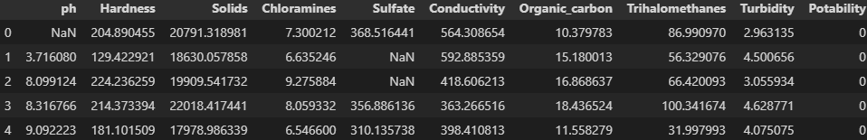
2.1
Thu thập dữ liệu
UNIT
02
The data is taken from Kaggle with 3276 samples with 10 columns:
Features: pH, Hardness, Solids, Chloramines, Sulfate, Conductivity, Organic_carbon, Trihalomethanes, Turbidity (9 columns, float64 type).
Target: Potability (0: undrinkable, 1: drinkable, int64 type).
Samsung Innovation Campus
Project Name
‹#›

Slide 6
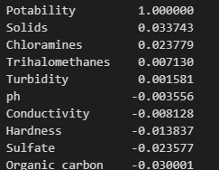
2.2
Data Analysis (EDA)
UNIT
02
The dataset is not a natural time series, but you can assume the order of the samples is a time series or create time windows to use GRU+LSTM
The dataset has missing values in columns like pH, Sulfate, and Trihalomethanes, which need to be handled.
The Potability column is a binary variable, which is good for classification, but if you want to predict a continuous value (e.g. pH), you need to adjust the objective.
All features have very low correlation with Potability (<0.04), indicating a complex classification problem, requiring a nonlinear model such as GRU+LSTM
Samsung Innovation Campus
Project Name
‹#›

Slide 7
2.3
Pre-processing
UNIT
02
Handling missing values:
Use SimpleImputer with median strategy to fill missing values for ph, Sulfate, Trihalomethanes columns.
Median is chosen because the features may not follow normal distribution, avoiding skewing the data.
Standardization:
Use StandardScaler to convert features to mean=0, std=1.
Make sure the data is on the same scale, suitable for GRU+LSTM model.
Result
X_train_num: (2784, 9) matrix with filled and normalized values.
X_test_num: (492, 9) matrix with filled and normalized values according to the same parameters from the training set.
Samsung Innovation Campus
Project Name
‹#›

Slide 8
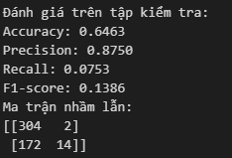
3.1
GRU model
UNIT
03
Use PyTorch to build a GRU model consisting of 1 GRU layer with 64 units, followed by Dropout and Dense.
=> High Precision but low Recall, indicating that the model is very conservative in predicting potable water. Most of the positive samples are missed.
Samsung Innovation Campus
Project Name
‹#›

Slide 9
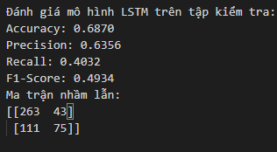
3.2
LSTM model
UNIT
03
LSTM model is built using Keras with 2 consecutive LSTM layers and output Dense layer using sigmoid. With the support of EarlyStopping.
=> The model is more balanced between Precision and Recall, giving better overall results than GRU.
Samsung Innovation Campus
Project Name
‹#›

Slide 10
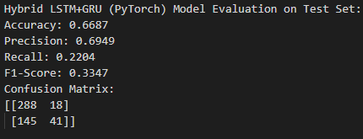
3.3
Hybrid Model
UNIT
03
The LSTM and GRU hybrid model is built using PyTorch to take advantage of the memorization capabilities of LSTM and the flexibility of GRU.
=> The hybrid model achieves a balance between GRU and LSTM, with higher Recall than GRU and higher Precision than LSTM, but is still limited in detecting positive samples.
Samsung Innovation Campus
Project Name
‹#›

Slide 11
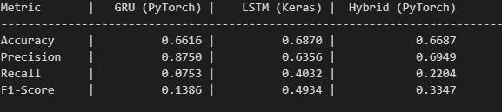
3.4
Compare models
UNIT
03
Best Model by Accuracy: LSTM (Keras) (0.6870)
Best Model by F1-Score: LSTM (Keras) (0.4934)
=> LSTM is still the best performing model overall. GRU has high accuracy on positives but misses many true positives. Hybrid has intermediate performance, showing potential with further tuning.
Samsung Innovation Campus
Project Name
‹#›

Slide 12
4
Application
UNIT
04
The model can be integrated into a rapid water quality testing system at home, in offices, or in areas lacking measuring equipment. In the future, sensors can be integrated to collect real-time data.
Reduce testing costs, increase feasibility in environmental monitoring. The biggest achievement is that the deep learning model can replace manual assessment in many specific cases.
Development direction:
Incorporate real-time data from IoT, expand to other water sources (rainwater, well water, industrial water), deploy into mobile applications or APIs to serve the community.
Samsung Innovation Campus
Project Name
‹#›

Slide 13


ⓒ2023 SAMSUNG. All rights reserved.
Samsung Electronics Corporate Citizenship Office holds the copyright of book.
This book is a literary property protected by copyright law so reprint and reproduction without permission are prohibited.
To use this book other than the curriculum of Samsung Innovation Campus or to use the entire or part of this book, you must receive written consent from copyright holder.

